Slide 1
Titanic dashboard
Problem Statement:-Find the Survivals according to their cabin numbers in Titanic Ship Accident on 15th April 1912 North Atlantic Ocean.

Slide 2
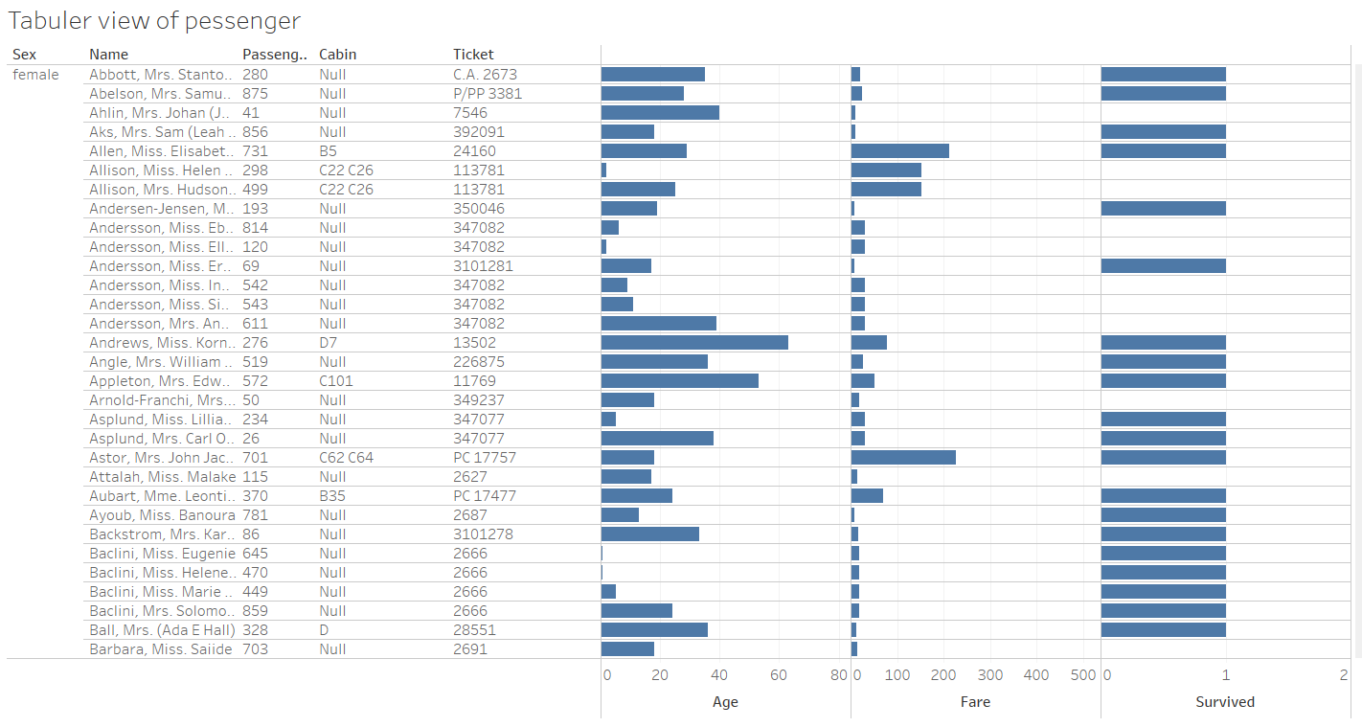
Tabuler view of passengers

Slide 3
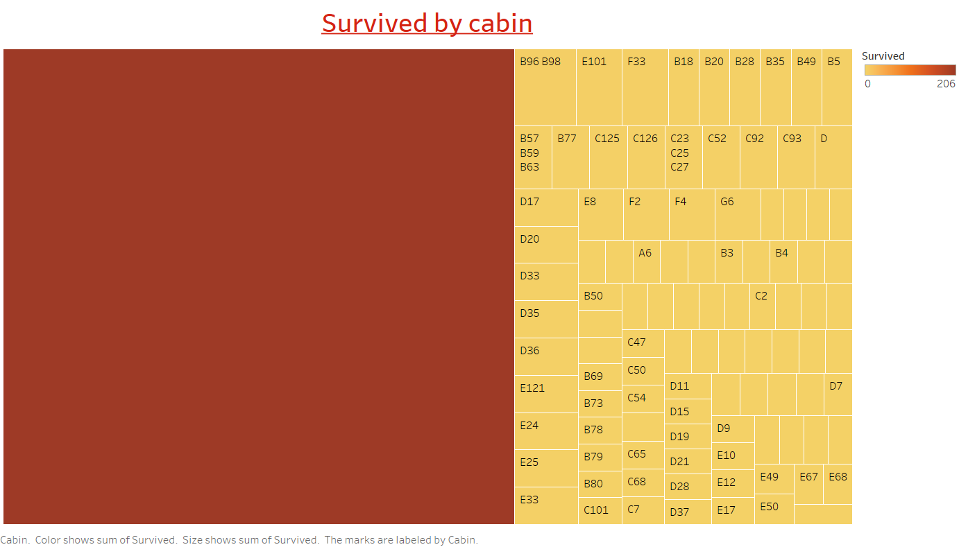

Slide 4
